Slide 1
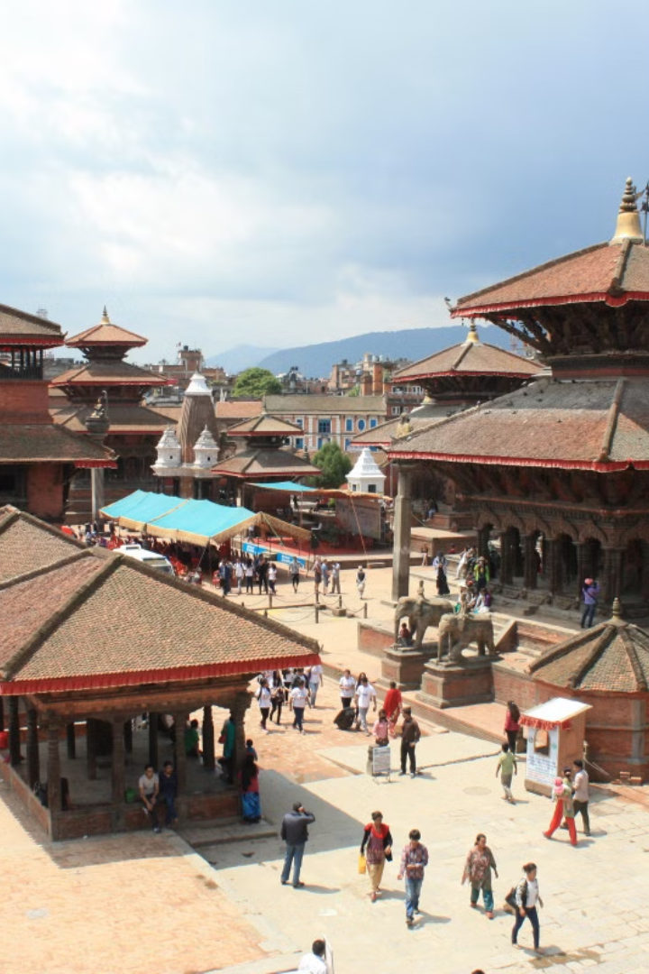
Introduction to Dhulikhel
Dhulikhel is one of Nepal’s oldest cities and a popular tourist attraction in the country. It is in the district of Kavrepalanchowk, at the eastern end of Kathmandu Valley. Dhulikhel is an important historical trading town on the primary trade route connecting Nepal and Tibet, with a rich cultural history, breathtaking vistas of Mount Everest, and a lively diversity.

Slide 2

Some facts about Dhulikhel
Located around 30 km east of Kathmandu, Dhulikhel is a popular destination for both local and international tourists. It is known for its stunning mountain views, ancient temples, and cultural richness. The city offers a peaceful retreat and is frequented by visitors seeking a serene getaway.

Slide 3
Destination Overview of Dhulikhel
1
Stunning Himalaya Views
In clear weather, snow-capped peaks of the Himalayan ranges from Mount Langtang (7,234m) in the west to Mount Everest (8,848m) in the east can be seen. Long views of agricultural land, including terraced rice fields and wooded regions, provide excellent chances for sight-seeing, particularly between October and March.
2
Adventure Tourism
Dhulikhel is a popular hiking and trekking destination, as well as mountain riding and cycling due to its clean environment, beauty, and links to cultural places. There are also several activities in the area, such as canyoning, bungee jumping, high rope, rafting, and bird viewing.
3
Agriculture Tourism
Dhulikhel has attracted agriculture-related value-added companies like cheese making with farm-gate retail and homestays. The homestay programs offer tourists the opportunity to experience the lifestyle and traditions of the local communities.

Slide 4

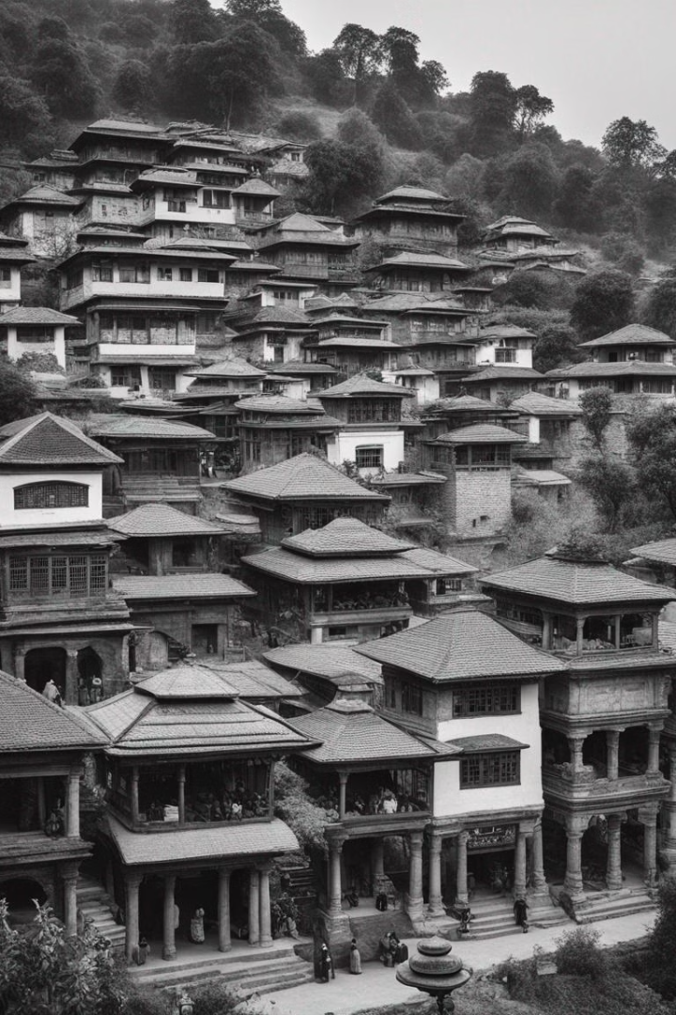
History of Dhulikhel
The name Dhulikhel originates from the Nepal Bhasha word Dhali_khela, which evolved from the earlier form Nepal Bhasha name Dhau_khyo. Dhali or Dhau means yogurt, and Khela or Khyo means a field in Nepala Bhasha. It is believed to have come from the Lichchhi name Dhawalasrotapura. Initially, Dhulikhel served as the eastern border of the ancient Nepal Mandala and was among the territories of the Bhaktapur kingdom.

Slide 5
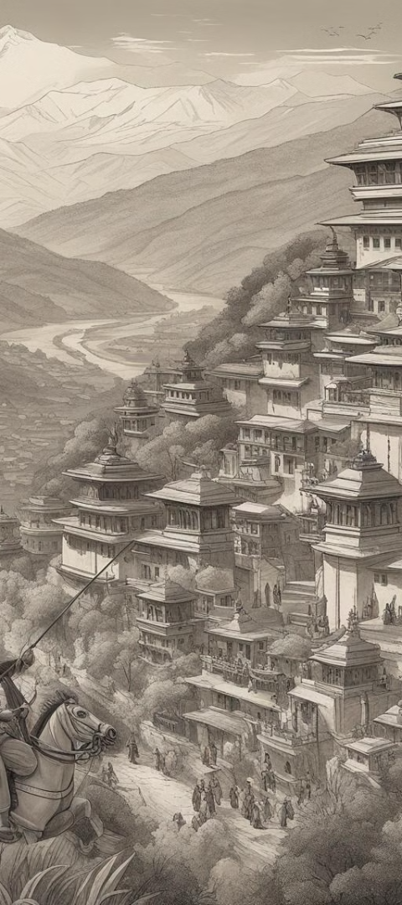



Formation of Dhulikhel
Resistance by Locals
The brave locals resisted the Gorkha kingdom expansion, with Prithvi Narayan Shah facing significant difficulties in capturing Dhulikhel.
Battle and Victory
After six months of intense fighting, Prithvi Narayan Shah successfully conquered Dhulikhel, leading to its annexation to the Gorkha kingdom.
Administrative Center Shift
Following its conquest, Dhulikhel became the administrative center of Kavrepalanchok, a position it retains till date.

Slide 6

Cultural Significance
1
Traditional Festivals
2
Local Crafts
Dhulikhel is renowned for its vibrant traditional festivals and celebrations, showcasing the rich cultural heritage of the region.
The town is known for its exquisite handcrafted goods, representing the skilled craftsmanship and artistic traditions of the local community.
3
Cultural Diversity
The diverse cultural influences in Dhulikhel contribute to a melting pot of traditions, beliefs, and practices.

Slide 7
Geographic Surroundings
Rural Landscape
Scenic Beauty
Environmental Diversity
The picturesque surroundings of Dhulikhel are characterized by rolling hills, lush forests, and vibrant agricultural fields, creating a serene and captivating environment.
The town's geography offers stunning panoramic views, attracting nature enthusiasts, hikers, and photographers from around the world.
The region's diverse landscape provides a habitat for a variety of flora and fauna, contributing to its ecological significance.

Slide 8
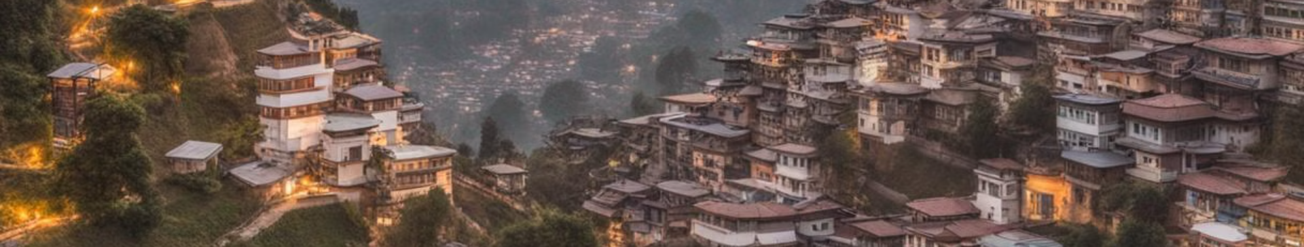
Modern Development
Urban Expansion
Cultural Revival
Educational Hub
Dhulikhel has witnessed rapid urban development, marked by the emergence of modern infrastructure and a bustling commercial center.
While embracing modernity, the town has successfully preserved its cultural heritage, inspiring a harmonious blend of tradition and progress.
It has become a prominent educational hub, offering a range of learning institutions and fostering intellectual growth and innovation in the region.

Slide 9
Dhulikhel’s Tourism Assets
Distinct Destinations
Physical Infrastructure
Dhulikhel’s cultural and tourism assets provide a snapshot of important tourism attractions, the obstacles associated with their development, sustainable management, and potential to further enhance assets or overcome growth constraints.
The physical infrastructure in Dhulikhel facilitates tourist transportation and visitor experience, contributing to the overall tourism appeal of the city.

Slide 10
Environmental Conservation
Scenic Trails
Opportunities for eco-tourism and outdoor recreation
Wildlife Conservation
Commitment to preserving the region's rich biodiversity and natural habitats
Green Initiatives
Efforts towards sustainable development and environmental protection

Slide 11
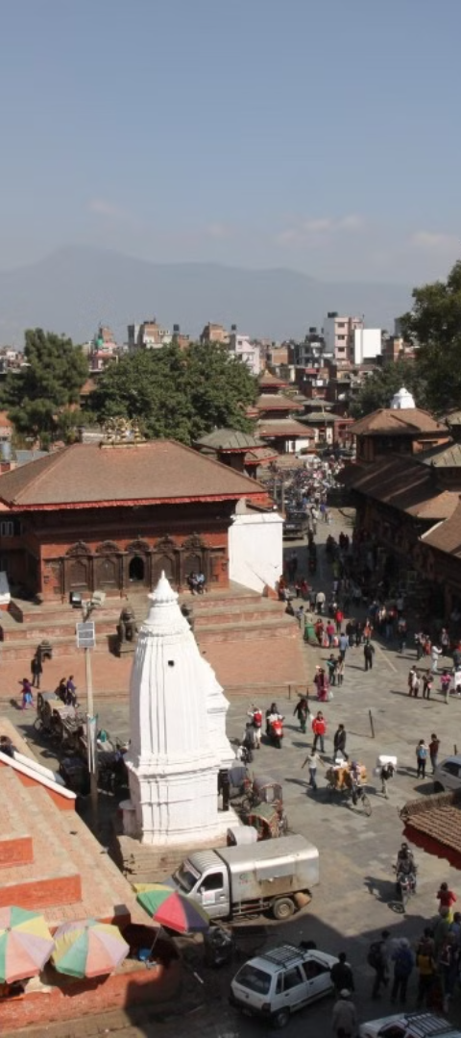
Dhulikhel’s Tourism Assets
1
Dhulikhel Tourism Landscape
Dhulikhel, located in the foothills of the Kathmandu Valley, is one of the most famous places in Nepal for viewing stunning Himalaya views.
2
Adventure Tourism
Dhulikhel is a popular hiking and trekking destination, as well as mountain riding and cycling due to its clean environment, beauty, and links to cultural places.
3
Agriculture Tourism
Agriculture is the most common land use in Dhulikhel due to which Dhulikhel has attracted agriculture-related value-added companies like cheese making with farm-gate retail and homestays.

Slide 12



Dhulikhel Tourism Landscape
Stunning Himalaya Views
Adventure Tourism
Agriculture Tourism
Dhulikhel is a popular hiking and trekking destination, as well as mountain riding and cycling due to its clean environment, beauty, and links to cultural places.
Dhulikhel has attracted agriculture-related value-added companies like cheese making with farm-gate retail and homestays.
In clear weather, snow-capped peaks of the Himalayan ranges from Mount Langtang (7,234m) in the west to Mount Everest (8,848m) in the east can be seen.

Slide 13
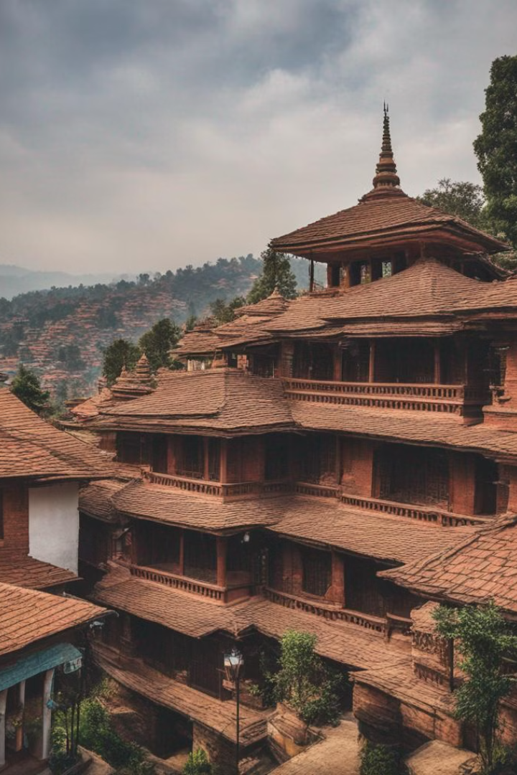

Dhulikhel: A Cultural Gem
Dhulikhel is blessed with many tangible built heritage assets, including the central "Old Town" area in Ward 5. This area is distinguished by two to four-story Newari-style residences with terracotta brick, mud plaster, terracotta gabled roofs, open windows, intricately carved wooden doors and windows, and a variety of decorative elements. The town also features pagoda-style temples, stone-carved statues, shrines, and intimate scaled medieval stone-paved streets. Other temples outside the old town include Shee Khandapur, Kali Temple, Gaukhureswor Mahadursthan, and Hazaar Sindhi.
by Atul Dhital

Slide 14
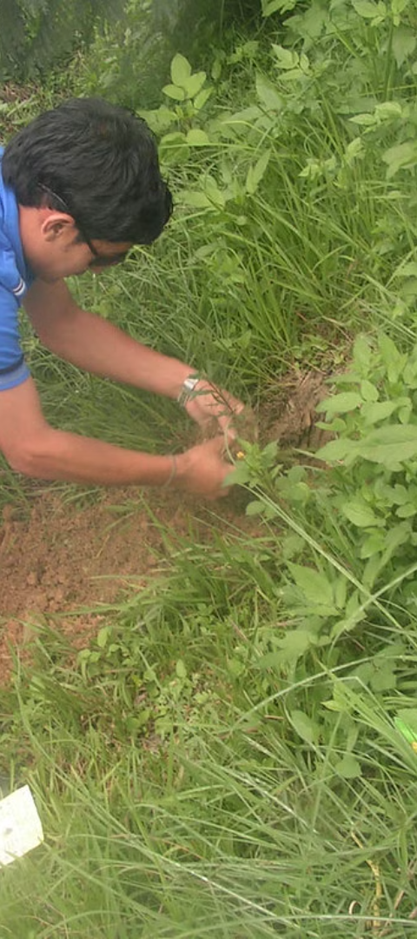
Tourist Accommodation in Dhulikhel
1
Diverse Options
2
Training Colleges
Dhulikhel offers a diverse choice of accommodation, including budget hotels, luxury hotels, and rural homestays. The majority of lodging is concentrated in urban regions, with new accommodation premises being the fastest expanding business category.
Dhulikhel has training colleges that teach students how to work in the hospitality industry, providing a significant resource for delivering high-quality lodging.
3
Major Hotels and Lodges
Notable establishments include Hotel Mount View Pty Ltd, Gaia Holiday Home, Hotel Gaurishanker Mountain View Pty Ltd, Dhulikhel Mountain Resort Kwawa, Himalayan Horizon Hotel Sun and Snow Pty Ltd, and Dhulikhel Lodge Resort.

Slide 15
Economic Activities in Dhulikhel
Tourism Revenue
Major Economic Activities
Tourism revenue is expected to provide a growing part of Dhulikhel’s foreign exchange revenues based on current trends. The industry has the potential to significantly enhance people’s living standards in the municipality by providing long-term job opportunities.
The Municipality has evident factors that provide a competitive edge for a variety of economic sectors, including agriculture, forestry, trade and business, transportation and logistics, and tourism.

Slide 16
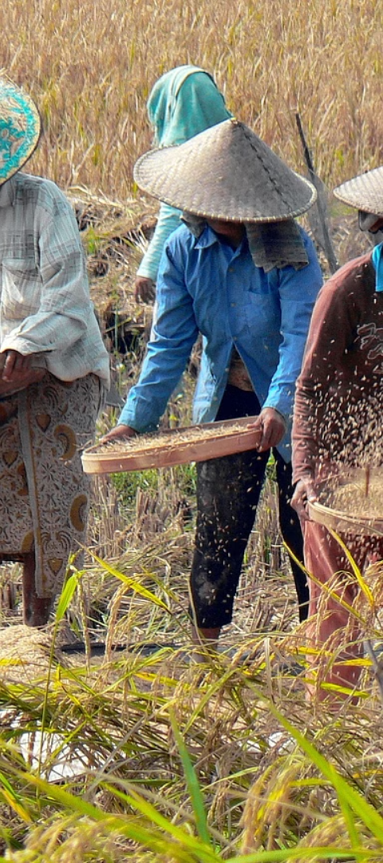
Agricultural Sector in Dhulikhel
1
Importance of Agriculture
2
Forestry
Agriculture is the region’s most important economic activity, providing both a living and a source of employment. The majority of people are employed in the production of cash crops such as rice, maize, and vegetables.
The region has Shorea robusta forest, Pinus roxburghe forest, and an intermediate zone of mixed forest, providing significant economic value through the sustainable utilization of forest resources.

Slide 17
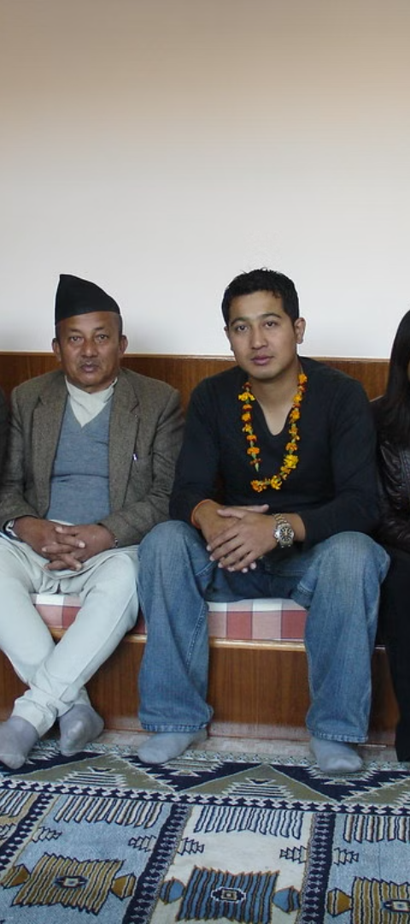
Trade and Business in Dhulikhel
Commercial Sector
Transportation and Logistics
Dhulikhel has a minor commercial sector known as Dhulikhel Bazar, which houses major banking institutions and retail establishments.
Dhulikhel serves as an important transportation and logistics center, with major national roadways linking the area.

Slide 18
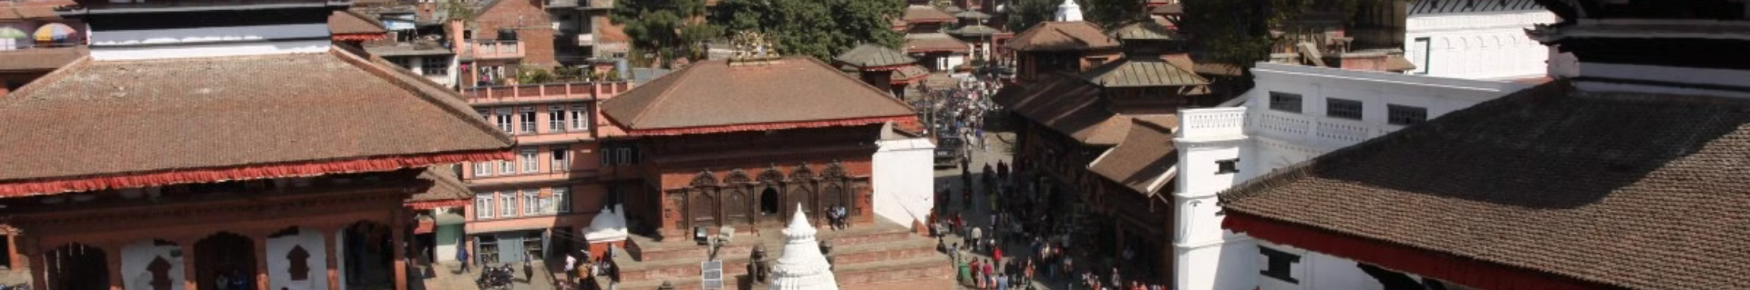
Tourism in Dhulikhel
Tourism Sector
1
Dhulikhel Municipality possesses natural, cultural, and religious attractions, resulting in a thriving tourism sector catering to domestic and international tourists.
2
Economic Impact
Tourism directly provides a significant number of full-time employment for local inhabitants and has the ability to significantly improve circumstances in the municipality.

Slide 19
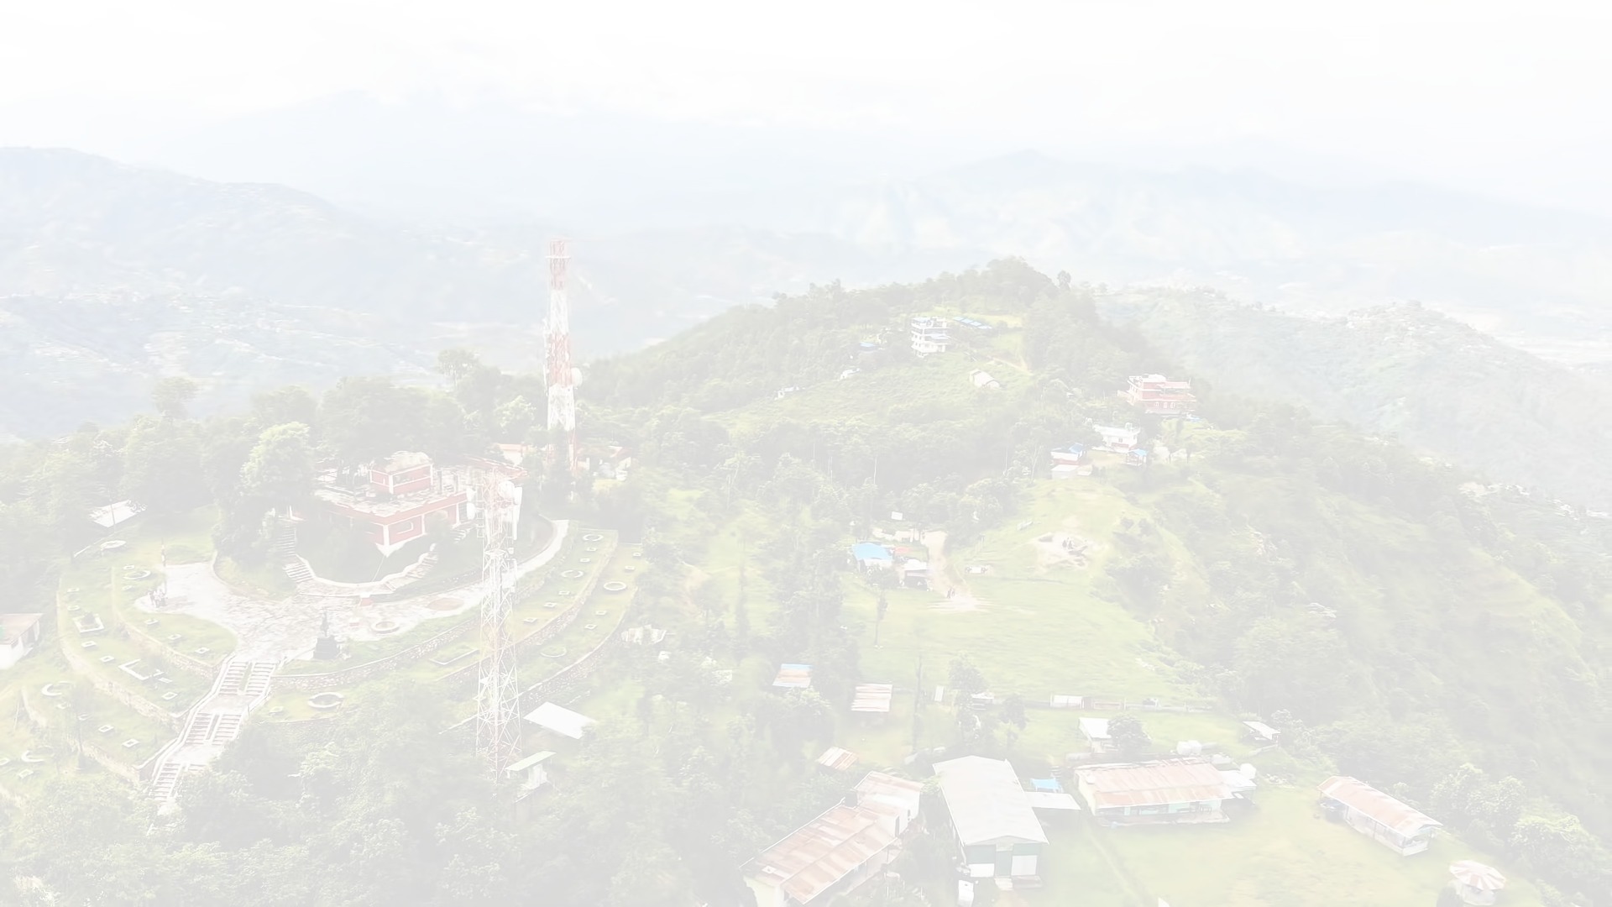
Discover the Hidden Gems of Dhulikhel
Escape to the idyllic town of Dhulikhel, where the stunning Himalayan views and rich culture await you. Explore the charming streets and traditional architecture of the historic town center, or venture out into the surrounding hills for a scenic hike. Whether you're looking for adventure or relaxation, Dhulikhel has something to offer every traveler. Don't miss out on this unforgettable destination!

Slide 20

Economic Activities in Dhulikhel
The Municipality of Dhulikhel has several factors that provide a competitive edge for a variety of economic sectors. Agriculture is the region's most important activity, with a variety of crops grown year-round. Forestry also provides significant economic value, while trade, transportation, and tourism are also major contributors to the local economy.

Slide 21
Tourism Development Strategies in Dhulikhel
The tourism development plan in Dhulikhel is based on six primary objectives, including the utilization of the municipality's historical and natural attractions, and the expansion and improvement of tourist accommodations and infrastructure. Specific measures are being taken to support these goals, such as developing a heritage strategy and establishing a Heritage Advisory Committee to support heritage decision-making.

Slide 22
Economic Impact of Tourism in Dhulikhel
25K
4
Full-time Jobs
Supplementary Services
Tourism directly provides a huge number of full-time employment for local inhabitants.
Income from different supplementary services for guests, such as arts and crafts production, has a positive economic impact.

Slide 23
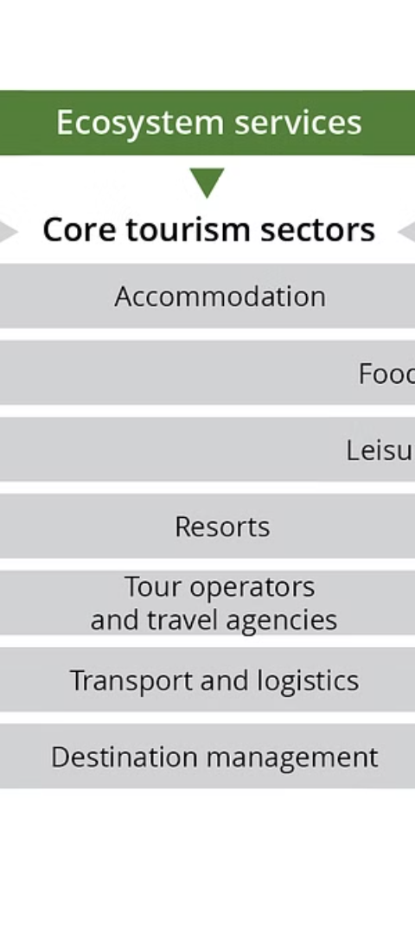


Tourism Development Issues in Dhulikhel
Concentration of Facilities
Hotel accommodation and tourist attractions are concentrated only in and around the bazaar area, limiting access to tourist destinations and activities.
Underutilized Areas
Rural and emerging areas have great potential but remain underutilized for tourism.

Slide 24
Preservation and Management in Dhulikhel
Major Historical and Landscape Values
Efficient management is required to safeguard and manage the development of major historical and landscape values within the municipality.
Integrated Strategy
To optimize tourist experiences, a more integrated strategy is required for intangible and tangible heritage.

Slide 25
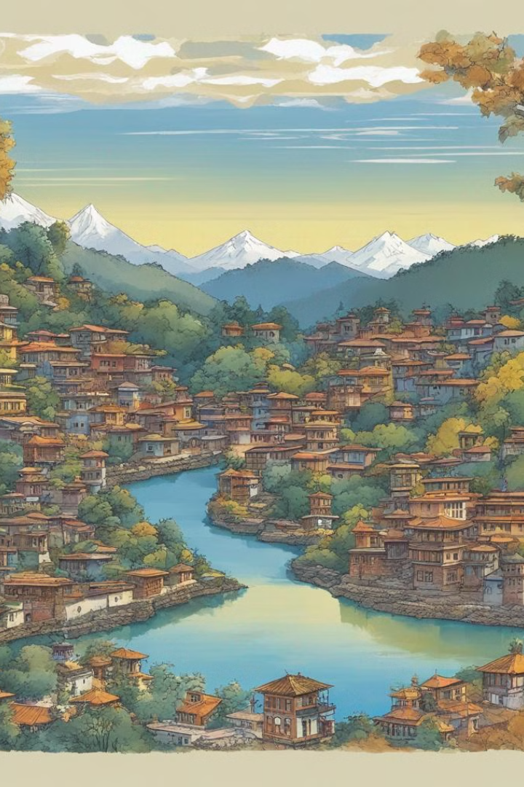
Recommendations and Action Plan
To enhance tourism in Dhulikhel, it is crucial to promote its rich cultural and historical landmarks. Recommendations include increasing promotion efforts, engaging local communities, and developing infrastructure. An action plan should include a tourism development strategy, a list of future tourism places, and potential religious tours, trekking, and cycling routes.

Slide 26
Conclusion
Dhulikhel's successful blend of culture and tourism has brought financial prosperity while preserving its rich history. By attracting visitors and generating revenue for local businesses, the town has improved the community while maintaining its authentic social personality. However, it's important to maintain a balance to avoid over-commercialization. Dhulikhel is a great example of how cultural tourism can support long-term financial prosperity while safeguarding tradition.

